Slide 1
Passenger Data & Railway performance

Slide 2
RAILWAY Agenda
THIS LIST CONTAINS THE CONTENTS OF PRESENTATION
Introduction | What is the project and what’s its objectives
Data collection | How we collected the data and understood it
Data cleaning | How we clean the data and what’s the tool we use to clean
Data analysis | What’s the programs we use to help us for analysis
Data visualization | Visualizing data and answer some important quesations
Conclusion | Summarizing some important points

Slide 3
Introduction
This project focuses on analyzing train operations by examining schedules, passenger data, and performance to identify patterns, enhance service, and support better decision-making. The process involved data cleaning, transformation, and modeling using Excel and SQL Server, where data was structured in tables with unique IDs. Power BI was used to create visual reports and answer key business questions ,there was some missing data, so we had to create new columns using DAX calculations. Despite some challenges we faced, we chose the appropriate structure for our database, selecting the right database structure, and choosing effective visuals, overcoming these issues improved the quality of analysis and contributed to more efficient train management.

Slide 4
Data Collection
The data was part of several projects, but we selected this project among six others to make a new contribution that could benefit the community and improve the infrastructure.
We were able to understand the data better, analyze its structure, and define the appropriate steps to take. We spent a week exploring and gaining deeper insights into the data using Excel to help us

Slide 5
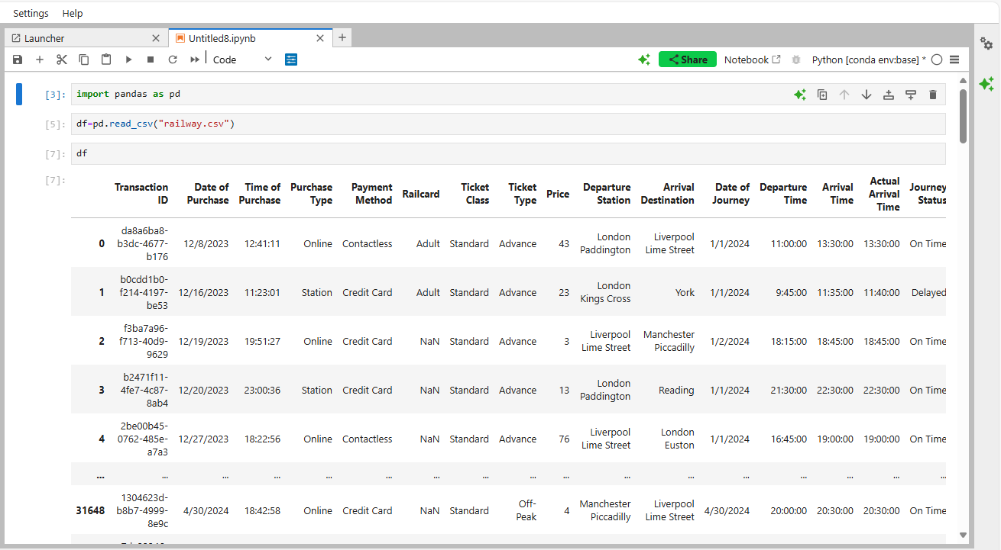
Data Cleaning
The first step involved importing the dataset from Excel into Python for preliminary exploration. This allowed us to assess data quality, identify missing values, and check the structure of the dataset. Pandas was used to load the data into a Data Frame, making it easier to clean and analyze.
Once the data was imported, it was cleaned to improve accuracy and consistency.
This included:
1- Handling missing values
2- Removing duplicate entries
3- Standardizing formats
4- Correcting inconsistencies

Slide 6
Data Analysis
01
02
Excel
SQL Server
We analyzed the data and split the main table into several sub-tables to make it easier to manage and link the data, and we organized them using it.
We used SQL Server to link, organize, and modify the data, and to answer some technical questions

Slide 7
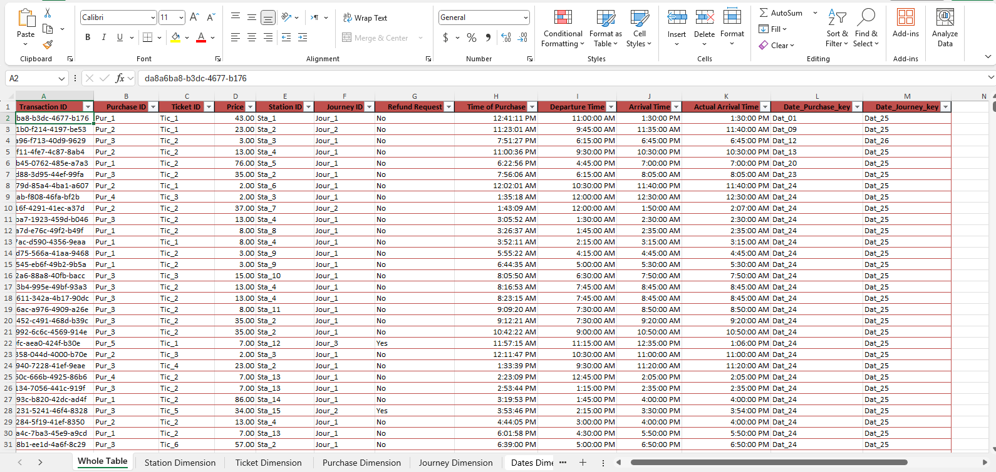
Excel
After cleaning, Excel was used to organize the dataset into separate tables before importing it into SQL Server:
• Splitting the data into multiple tables (e.g., train schedules, delays, passenger records).
• Creating unique IDs for each record using CONCAT to merge multiple fields.
• Applying VLOOKUP to link related data points across sheets.
This step ensured the data was well-structured for database storage and easy retrieval.
01

Slide 8
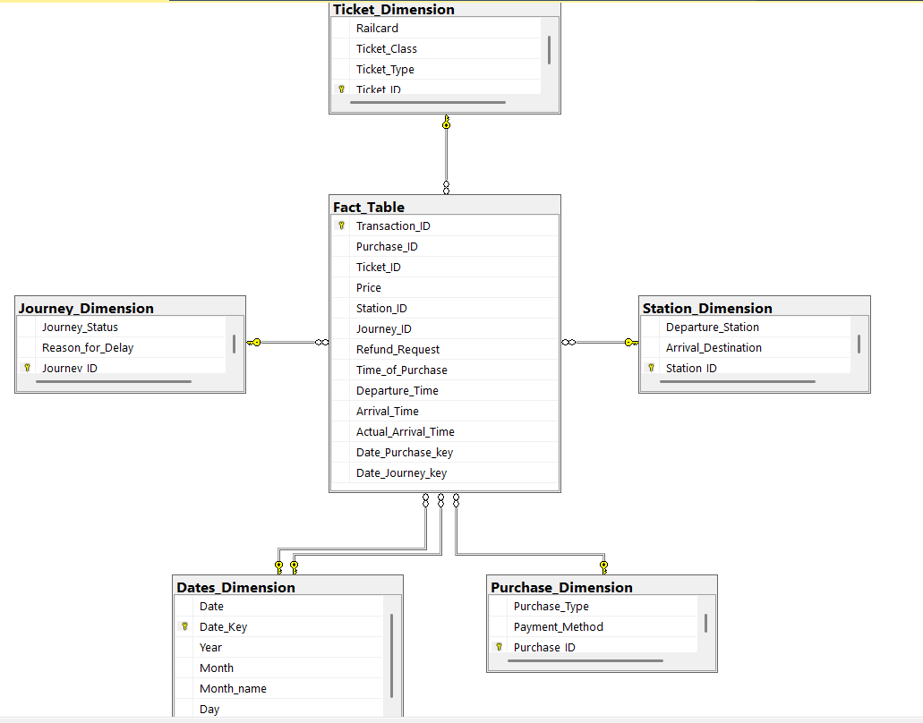
SQL Server
After organized the data, it was stored in a relational database using SQL Server.
The database was designed to ensure efficient data management and fast query execution.
The schema included:
• Separate tables for train schedules, passenger records, and delays.
• Primary Keys and Foreign Keys to establish relationships between tables.
02

Slide 9
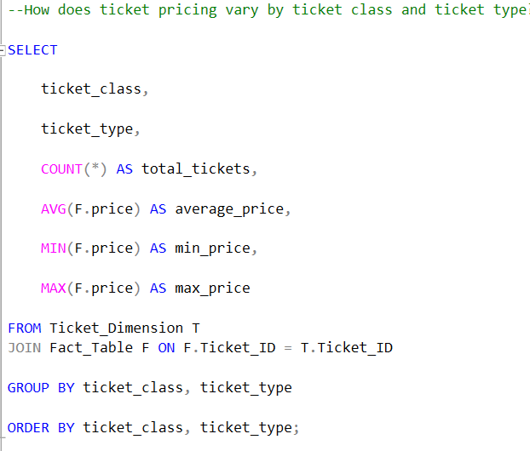
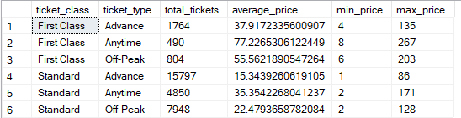
SQL Server
How does ticket pricing vary by ticket class and ticket type ?
02

Slide 10
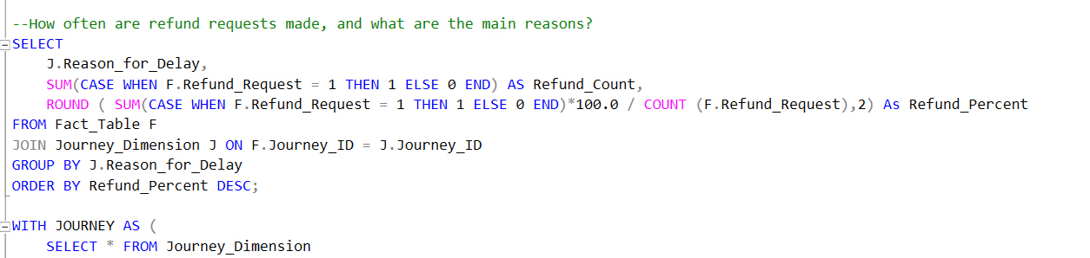
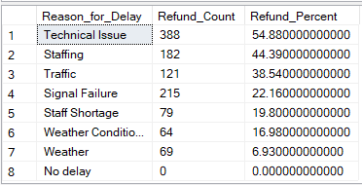
SQL Server
How often are refund requests made, and what are the main reasons?
02

Slide 11
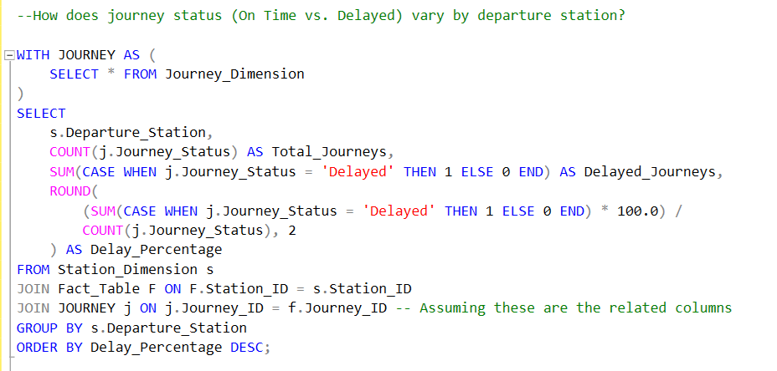
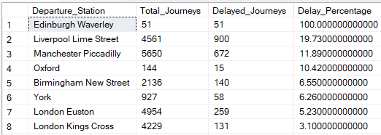
SQL Server
How does journey status (On Time vs. Delayed) vary by departure station?
02

Slide 12
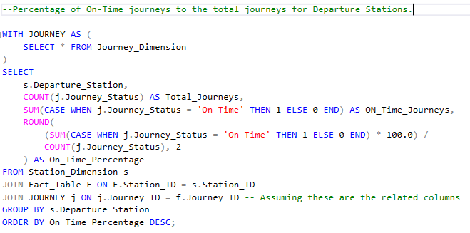
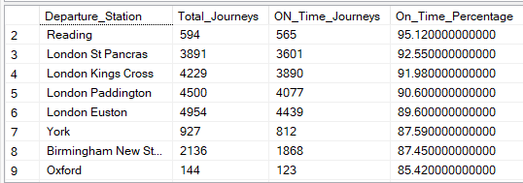
SQL Server
Percentage of On-Time journeys to the total journeys for Departure Stations?
02

Slide 13
Data visualization
Once the processed data was stored in SQL Server, it was imported into Power BI for visualization. The key steps included:
• Creating interactive dashboards to display train performance metrics.
• Using DAX calculations to generate key insights (e.g., average delay time, busiest stations).
• Applying charts and heatmaps to highlight performance trends.
These visualizations provided clear and
actionable insights for decision-makers.

Slide 14
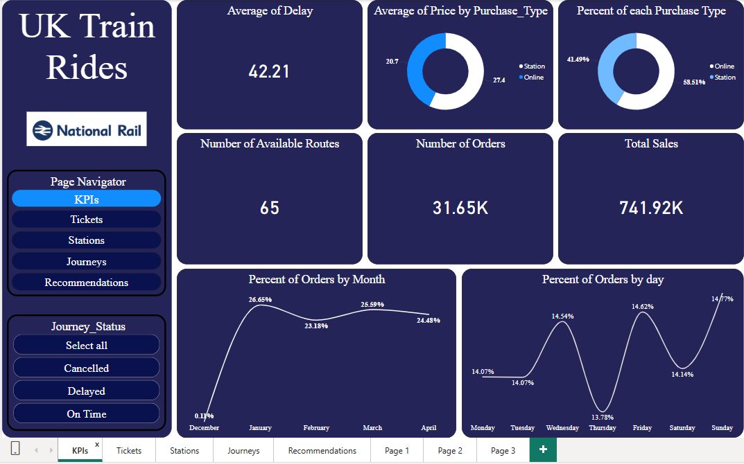
Recommendations
KPIs
1. High Average Delay Time:
Investigate the causes of delays and implement solutions to reduce them.
2. High Station Sales with Increasing Online Purchases:
Introduce incentives to encourage more online ticket purchases.
3. Lower December Sales:
December sales are lower due to the limited number of days in the dataset.
4. Lowest Sales on Thursdays:
Offer incentives, such as ticket discounts, to boost sales on Thursdays.

Slide 15
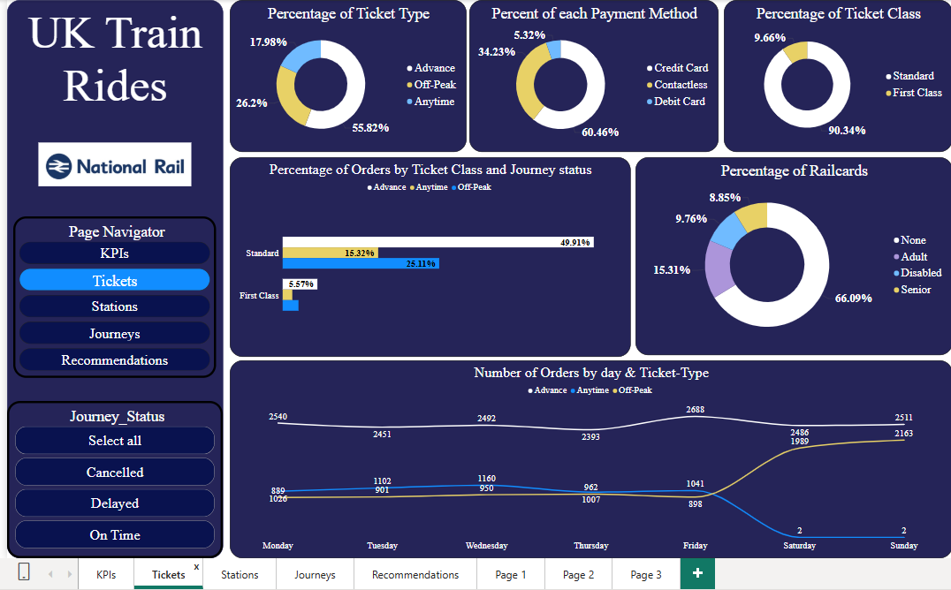
Recommendations
Tickets
1. Advance Tickets Are the Most Popular:
Improve Advance ticket availability or introduce loyalty programs with premium ticket options.
2. First Class Tickets Only Make Up 10%:
Provide incentives or discounts during low-occupancy periods to increase First Class sales.
3. Most Passengers Lack Rail-cards:
Launch awareness campaigns—especially targeting university students—about Railcard benefits.
4. Station Ticket Purchases:
Introduce easier, faster payment methods, particularly contactless options.
5.Anytime Ticket Sales Drop During Holidays:
Investigate the reasons behind this trend to help boost sales during holidays.
6. Anytime Tickets Have the Lowest Delay and Cancellation Rates:
Leverage this advantage as a Unique Selling Proposition (USP) in marketing.

Slide 16
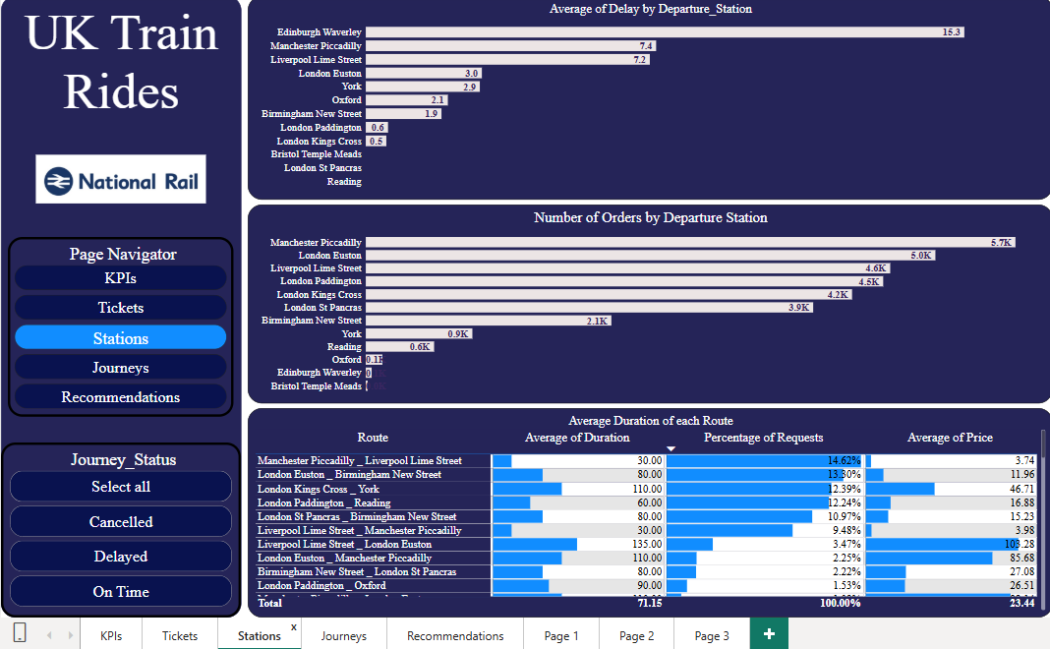
Recommendations
Stations
1. Stations with High Demand and Delays (e.g., Manchester Piccadilly, London Euston):
Urgently address and resolve delay issues at these stations.
2. Low Demand Stations (e.g., Bristol Temple Meads):
Investigate causes for low usage and consider promotional or operational strategies.
3. Long-Duration Routes Have Fewer Orders:
Improve these routes by making them faster, more affordable, or rescheduling for convenience.
4. High-Demand Stations:
Promote off-peak discounts to help distribute demand throughout the day.
5. Routes with Frequent Cancellations and Delays:
Prioritize maintenance and performance improvements.
6. Evaluate ROI by Station:
Calculate return on investment for each station to prioritize funding and development.

Slide 17
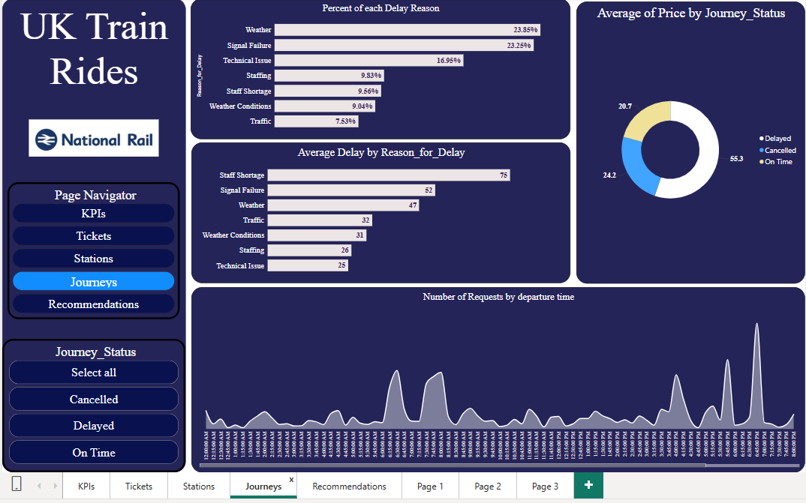
Recommendations
Journeys
1. Weather and Signal Failures Are the Most Common Delay Causes:
Invest in weather-resistant infrastructure and modern signaling systems.
2.Staff Shortages Cause the Longest Delays:
Prioritize hiring and staff optimization.
Use shift-based scheduling and emergency staff pools.
3. Real-Time Delay Risk Alerts:
Send alerts for journeys at high risk of delay (e.g., due to staff shortage or weather).
4. Peak Delay Periods:
Identify and resolve causes of delays and cancellations that occur at specific times of the day.

Slide 18
Conclusion
1. Resolve major delay causes like staff shortages, weather, and signal failure through infrastructure and staffing improvements.
2. Anytime Tickets’ reliability as a Unique Selling Proposition (USP) to boost sales.
3. Encourage online purchases with targeted incentives and digital-first strategies.
4. Prioritize high-demand, high-delay stations (e.g., Manchester Piccadilly) for immediate operational improvements.
5. Launch Rail-card awareness campaigns to increase usage, especially among students.

Slide 19
Thank You!
Any Questions?

